Slide 1






Project Management
“A project without a critical path is like a ship without a rudder”

Slide 2









PRESENTATION PLAN
WHAT İS THE PROJECT ?
PROJECT MANAGER
PROJECT SUCCESS CRİTERİA
PROJECT STAKEHOLDERS
PROJECT MANAGEMENT
CERTİFİCATES
IMPORTANCE OF PROJECT MANAGEMENT
PROJECT MANAGEMENT LİFE CYCLE

Slide 3

what is the project ?

Slide 4

PROJECT
Projects are born from need
A project is produced to solve a need or a problem.
A project is made for a vision, a dream.
Dreams are turned into reality with a project in advance with a good vision.
is defined as a “temporary endeavor with a beginning and an end and it must be used to create a unique product
The project may be finite but not the result.
For instance, a project to build a monument would be of fixed duration whereas the result that is the monument may be for an indefinite period in time.

Slide 5




PROJECT SUCCESS CRİTERİA
Project Time
Project time management involves analyzing and developing a schedule and timeline for project completion.
Projects made in the planned time, budget and quality are considered successful projects.
Project Budget
A project budget is the total projected costs needed to complete a project over a defined period of time.
Project Quality
Project Quality includes the processes and activities that determine quality policies, objectives and responsibilities so that the project will satisfy the needs for which it was undertaken.

Slide 6


WHAT IS PROJECT MANAGEMENT ?

Slide 7

TOPİCS TO TALK ABOUT
IMPORTANCE OF PROJECT MANAGEMENT
PROJECT MANAGEMENT
is the use of specific knowledge, skills, tools and techniques to deliver something of value to people. The development of software for an improved business process, the construction of a building, the relief effort after a natural disaster, the expansion of sales into a new geographic market
PROJECT MANAGERS
PROJECT MANAGEMENT CERTİFİCATİONS
PROJECT MANAGEMENT LİFE CYCLE

Slide 8


01
Alignment
The project manager ensures that the objectives of the final deliverable are well aligned with the strategic goals of the client.
IMPORTANCE OF PROJECT MANAGEMENT
Leadership
A project manager ensures there is no confusion, no hassles in the course of the project and it is completed smoothly.
02
Clear Purpose
A good project manager needs to have the vision to adopt such an approach.
03

Slide 9


Quality
When a team works on any project for any client then the first thing expected out of them is quality.
04
Managing Risk Involved
A project manager helps to avoid risk against various hassles that come in the way of project completion.
05
Achievable Objectives
Effective project managers negotiate achievable deadlines with the client, team, and management.
06

Slide 10


PROJECT MANAGER
40
30
Project managers play the lead role in planning, executing, monitoring, controlling, and closing out projects. They are accountable for the entire project scope, the project team and resources, the project budget, and the success or failure of the project.
20
10
0
Item 1
Item 2
Item 3
Item 4

Slide 11




BECOME A PROJECT MANAGER
Project managers are first point of contact for any issues or discrepancies arising from within the heads of various departments in an organization before the problem escalates to higher authorities, as project representative.
training and certifications
must take the necessary trainings given by some institutions
have some certificates given at the end of the trainings.
talents and skills
be able to lead,
pay attention to details have the ability to solve problems
communicate well with people.

Slide 12
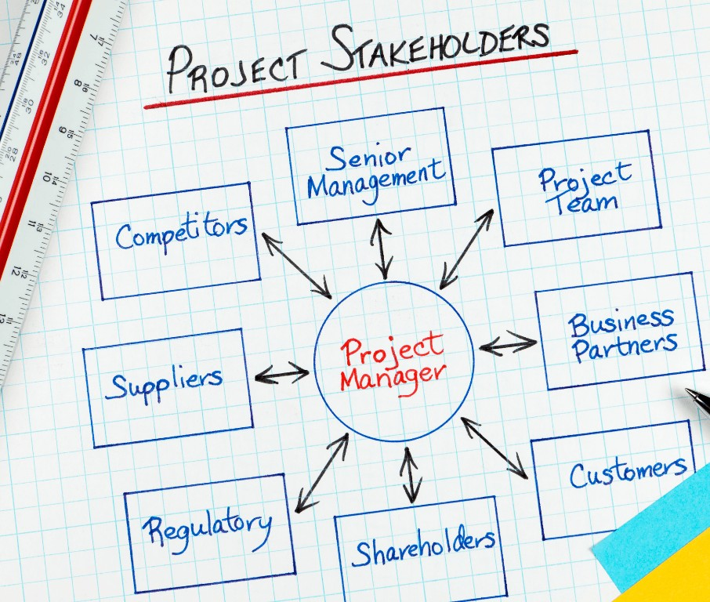

PROJECT STAKEHOLDERS
For example, customer, sponsor, employee organization, public institutions.

Slide 13



CERTİFİCATES
Project Management Professional (PMP)
PRojects IN Controlled Environments (Prince2)
Certified Scrum Master (CSM)

Slide 14



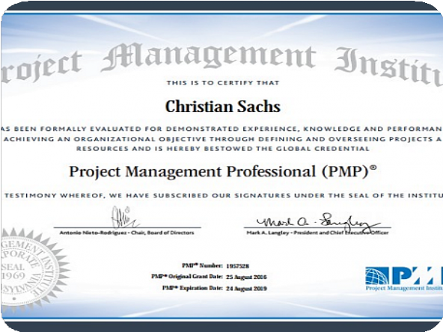
Project Management Professional (PMP)
PMI calls its internationally recognized certification “the gold standard of project management.” The Project Management Institute does not endorse specific review courses, resources, references, or any other materials for the PMP certification preparation. However, they do reference a list of ten resources including their Project Management Body of Knowledge (PMBOK) and the Agile practice guide.
A PMP certification signifies your capability to speak the global language of project management and indicates that you can work as a project manager in virtually any industry following any methodology in any location.

Slide 15



PRojects IN Controlled Environments (Prince2)
The PRINCE2 certification is a process-based project management method that offers a systematic approach to delivering a successful project with clear templates, processes, and steps. PRINCE2 is administered in the UK by the APMG.
Prince2 Practitioner certificate is valid for 3 years. After this term, you can retake the exam to continue your credentials or you have the option to renew it through an Axelos Membership.

Slide 16




Certified Scrum Master (CSM)
The CSM certification official provider is the Scrum Alliance. The CSM certification gives a comprehensive overview of the Scrum framework for agile project management i.e.
The CSM certification is valid for 2 years. To maintain the certification beyond, it’s required to complete 20 Scrum Education Units (SEUs), along with a renewal fee.

Slide 17




PROJECT MANAGEMENT LİFE CYCLE

Slide 18
01
Project Initiation
This is the starting phase where the project manager must prove that the project has value and is feasible.
02
Project Planning
After the project has been approved, the project moves into the second project management phase: project
05
Project Closure
planning.
in which the final deliverables are presented to the client or stakeholder.
04
03
Project Monitoring and Control
project monitoring and control, takes place concurrently with the execution phase of the project.
Project Execution
The third project management phase is project execution

Slide 19
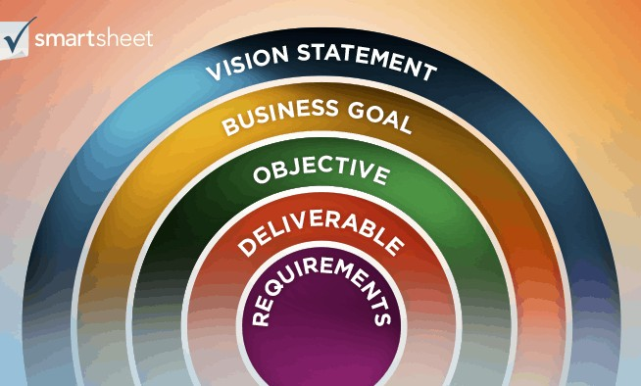


PROJECT INITIATION
The initiation phase encompasses all the steps you must take before a project is approved and any planning begins.
Create a Project Charter
Key participants and stakeholders, scope, objectives, and overall goals.
Define Scope
Project scope is the identification of the project’s goals, deliverables, budget, and schedule. .
Identify Project Objectives
Measurable and must meet time, budget, and quality constraints

Slide 20
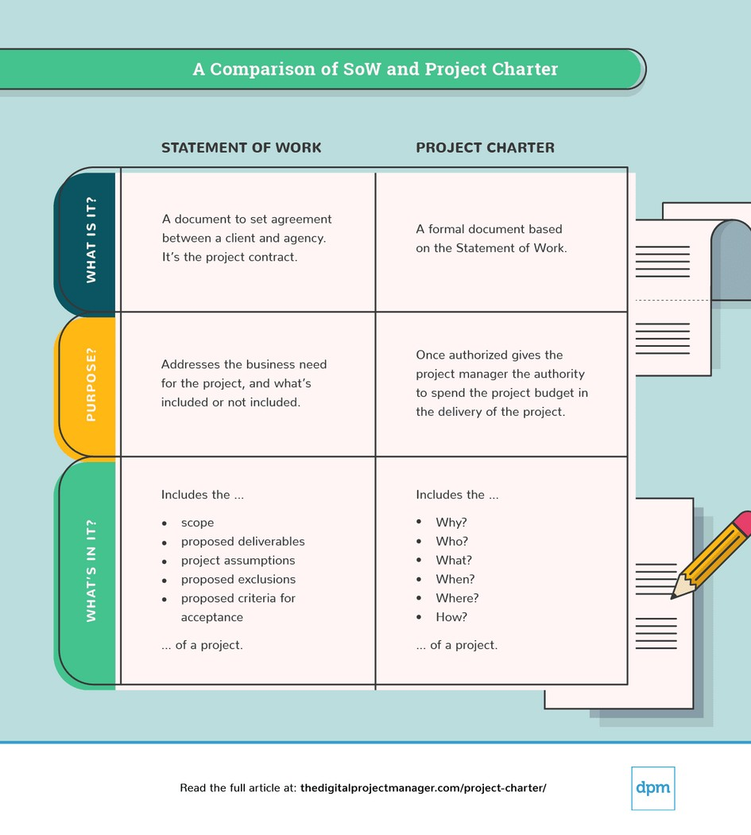


PROJECT PLANNİNG
Your project plan is essential to the success of any project.
Create a Project
Create a Project
Cr_{C}ea_{h}t_{a}e_{rt}a_{e}P_{r} roject
Organiz_{C}e_{h}y_{a}o_{rt}u_{e}r_{r}project
List the necessary project resources
such as personnel, equipment, salaries, and materials, then estimate their cost.
Charter
team
It includes details, like business needs,^{D}k^{e}e^{f}y^{in}p^{e}a^{y}rºti^{u}ci^{r}p^{p}a^{r}nºt^{j}s^{ec}a^{t}n^{’s}d stake^{s}h^{ta}o^{k}ld^{e}e^{h}rºs^{l},^{d}s^{e}c^{r}o^{s}p, e^{sc}, ºo^{p}b^{e}je,c^{q}t^{u}ivªe^{l}s^{it},^{y}
_{a}b_{n}a_{d}se_{o}l_{v}in_{e}e_{ra}, _{l}d_{l} e_{g}l_{o}iv_{a}e_{ls}ra. bles,
requirements.
It includes details, like business c_{n}u_{e}s_{e}to_{d}m_{s,} e_{k}r_{e}s_{y}, s_{p}t_{a}a_{r}k_{t}e_{ic}h_{ip}o_{a}ld_{n}e_{t}r_{s}s_{a}a_{n}n_{d}d
stake^{d}h^{e}o^{f}l^{i}d^{n}e^{e}rs^{th}, s^{e}c^{ir}o^{r}pºe^{le}, ^{s}obªj^{n}e^{d}ctives, _{an}re_{d}sp_{ov}o_{e}n_{r}s_{a}ib_{ll}i_{g}lit_{o}ie_{a}s_{ls}..

Slide 21


PROJECT EXECUTİON
Following processes
During the planning phase of project management,
Make project execution a priority
While executing your plan might sound like the easy part, considering all the work that went into the planning phase
Managing people
Making sure your personnel are following the project plan is essential

Slide 22

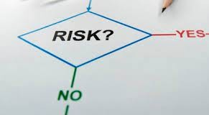

PROJECT MONİTORİNG AND CONTROL
The project monitoring and control process aims at tracking and reviewing the project and is undertaken from the initiation of the project to its closure.
Create a Project ^{C}A^{h}dªm^{rt}i^{e}n^{r}ister
Create a Project Impleme^{C}n^{h}tªR^{rt}i^{e}s^{r}k Mitigation
Monitor and Control Project Work
It include_{P}s _{r}d_{o}et_{c}a_{u}ils_{r},_{e}lik_{m}e _{e}bu_{n}s_{t}in_{s}ess
It includes deta_{P}ils_{l},_{a}li_{n}ke business
needs, key participants and stakeholders, scope, objectives, and overall goals.
needs, key participants and stakeholders, scope, objectives, and overall goals.

Slide 23




PROJECT CLOSURE
So much time and effort is put into the planning of a project, it is often forgotten that the end of a project is equally important.k involved even once a project is technically complete.
Project Closure Checklist
To make sure that every i is dotted and t crossed,
Complete Paperwork
As noted, projects generate reams of documents.
Archive Documents
There are lessons to be learned from old projects,

Slide 24



References
-https://ocw.mit.edu/courses/aeronautics-and-astronautics/16-885j- aircraft-systems-engineering-fall-2005/readings/sefguide_01_01.pdf
-https://en.wikipedia.org/wiki/Project_management
-https://www.pmi.org/about/learn-about-pmi/who-are-project- managers
-https://www.pmi.org/about/learn-about-pmi/what-is-project- management
-https://www.teamwork.com/project-management-guide/why-is- project-management-important/

